Slide 1
My Perimeter, Area and Volume Interactive Notebook
Name
Class
Term 3 Semester 2

Slide 2
Contents
Formula Page
Page
Date
Description
2
3

Slide 3
Tasks
24
7
30
Essential Question
Questions
Notes
Summary
12
13

Slide 4
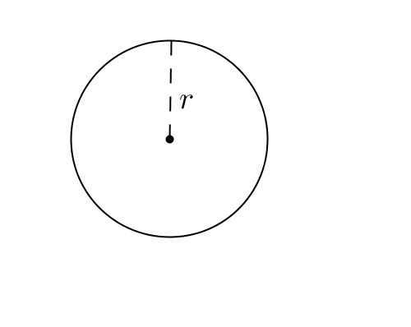

24
7
30
Date
Area of circles and sectors
EQ – How do I use formula of a circle to find the area of a sector?
Formula:
$$Area=πr^{2}$$
3m
13

Slide 5

24
7
30
Date
Area of circles and sectors
EQ – How do I use formula of a circle to find the area of a sector?
Formula:
$$Area=πr^{2}$$
$$Area=πr^{2}$$
3m
13

Slide 6
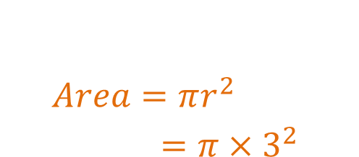
24
7
30
Date
Area of circles and sectors
EQ – How do I use formula of a circle to find the area of a sector?
Formula:
$$Area=πr^{2}$$
$$Area=πr^{2} =π×3^{2}$$
3m
13

Slide 7
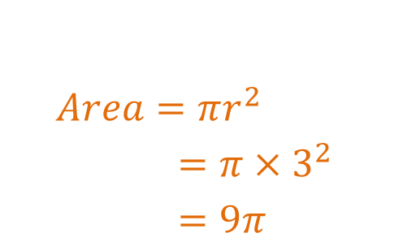
24
7
30
Date
Area of circles and sectors
EQ – How do I use formula of a circle to find the area of a sector?
Formula:
$$Area=πr^{2}$$
$$Area=πr^{2} =π×3^{2} =9π$$
3m
13

Slide 8
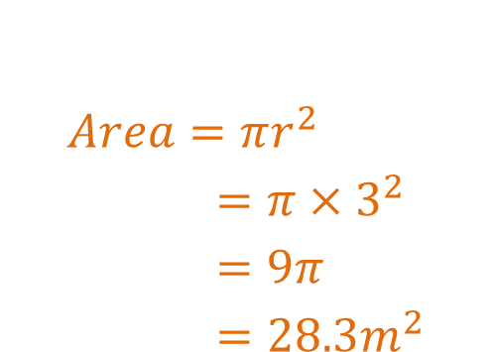
24
7
30
Date
Area of circles and sectors
EQ – How do I use formula of a circle to find the area of a sector?
Formula:
$$Area=πr^{2}$$
$$Area=πr^{2} =π×3^{2} =9π=28.3m^{2}$$
3m
13

Slide 9
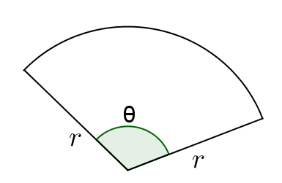
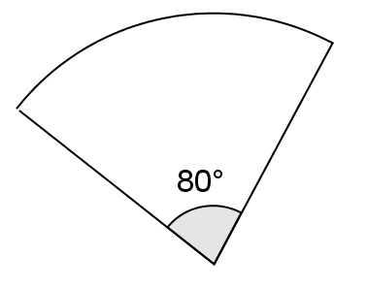
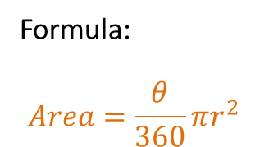
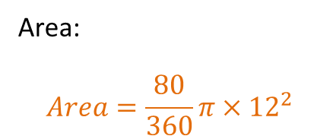
24
7
30
Date
Area of circles and sectors
EQ – How do I use formula of a circle to find the area of a sector?
Formula:
$$Area=\frac{θ}{360}πr^{2}$$
Area:
$$Area=\frac{80}{360}π{×12}^{2}$$
12cm
13

Slide 10
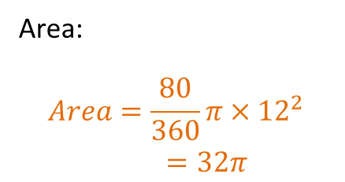
24
7
30
Date
Area of circles and sectors
EQ – How do I use formula of a circle to find the area of a sector?
Formula:
$$Area=\frac{θ}{360}πr^{2}$$
Area:
$$Area=\frac{80}{360}π{×12}^{2}=32π$$
12cm
13

Slide 11
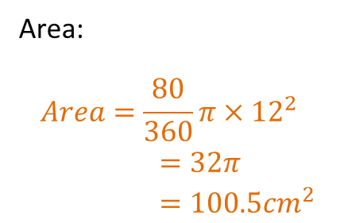
24
7
30
Date
Area of circles and sectors
EQ – How do I use formula of a circle to find the area of a sector?
Formula:
$$Area=\frac{θ}{360}πr^{2}$$
Area:
$$Area=\frac{80}{360}π{×12}^{2}=32π=100.5{cm}^{2}$$
12cm
13

Slide 12
Questions

Slide 13
24
7
30
Date
Area of circles and sectors
EQ – How do I use formula of a circle to find the area of a sector?
How do I find the area of a circle?
Formula:
$$Area=πr^{2}$$
$$Area=πr^{2} =π×3^{2} =9π=28.3m^{2}$$
Example
3m
13

Slide 14
24
7
30
Date
Area of circles and sectors
EQ – How do I use formula of a circle to find the area of a sector?
How do I find the area of a sector?
Formula:
$$Area=\frac{θ}{360}πr^{2}$$
Example
Area:
$$Area=\frac{80}{360}π{×12}^{2}=32π=100.5{cm}^{2}$$
12cm
13

Slide 15
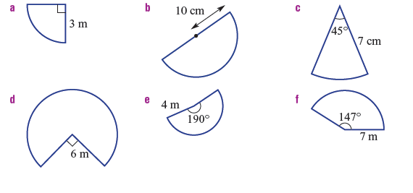
Textbook page 282

Slide 16


Textbook page 282

Slide 17
Notes Review
24, 7 ,30
Date
Title
Essential question
Notes complete
Notes complete with colour and diagrams
Questions completed
Contents page filed in
Formula page filled in

Slide 18
Homework
Review your notes and write a summary answering the essential question.
Complete Area worksheet

Slide 19
Plenary
Draw three shapes with a perimeter of 36cm.

